Slide 1
The Foreign Subsidies Regulation a new tool to create a level playing field in the EU
Meet to Compete – Competition Law and Policy
9 May 2024
Eddy De Smijter
Head of Unit Foreign Subsidies
DG Competition

Slide 2
Purpose and problem definition
Objective: Ensuring a level playing field to foster investments in the EU
  EU control of State aid granted by Member States,
  but no control of foreign subsidies
  Foreign subsidies may cause distortions on the internal market
Gap analysis
  Competition instruments, trade policy and public procurement rules do not adequately tackle distortions caused by foreign subsidies

Slide 3
Some guiding principles
Maintain trade and investment flows
  Target most distortive foreign subsidies
  Minimise administrative burden
Respect international obligations, in particular WTO compatibility
  Comply with non-discrimination, national treatment principles
  Avoid conflict with existing rules (e.g. ASCM)

Slide 4
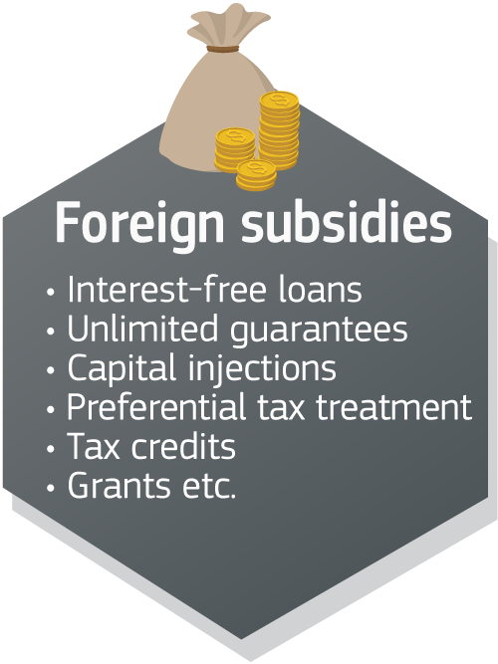
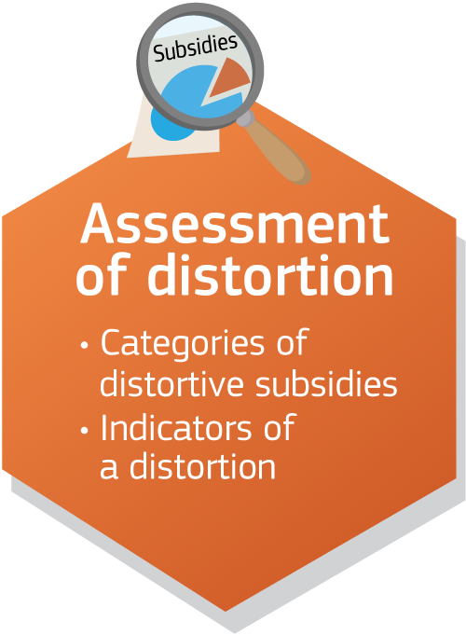
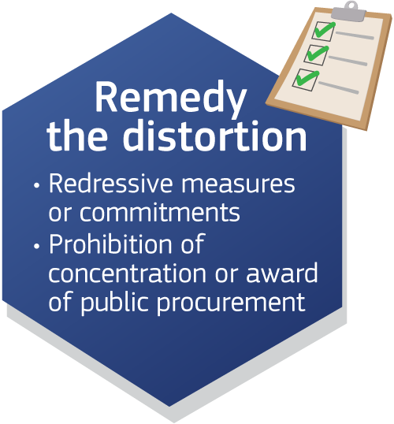


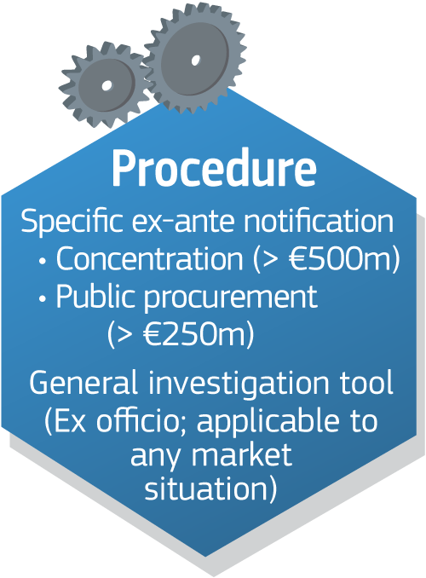
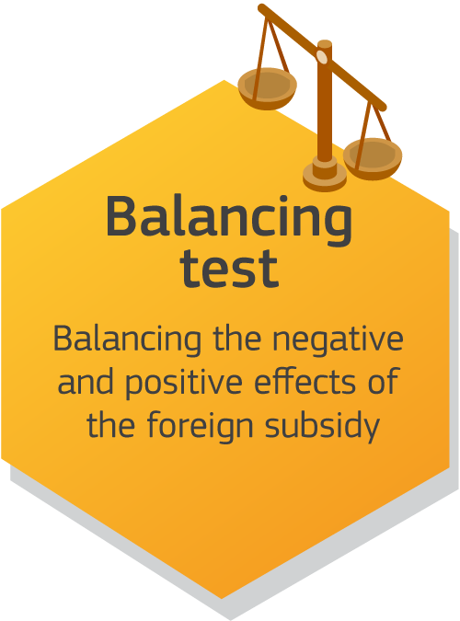
The FSR at a glance
, foregone revenue

Slide 5
Definition of foreign subsidy
Four cumulative conditions:
Financial contribution
Limited to one or more undertakings or industries
Confers a benefit
Provided directly or indirectly by third country
, foregone revenue

Slide 6
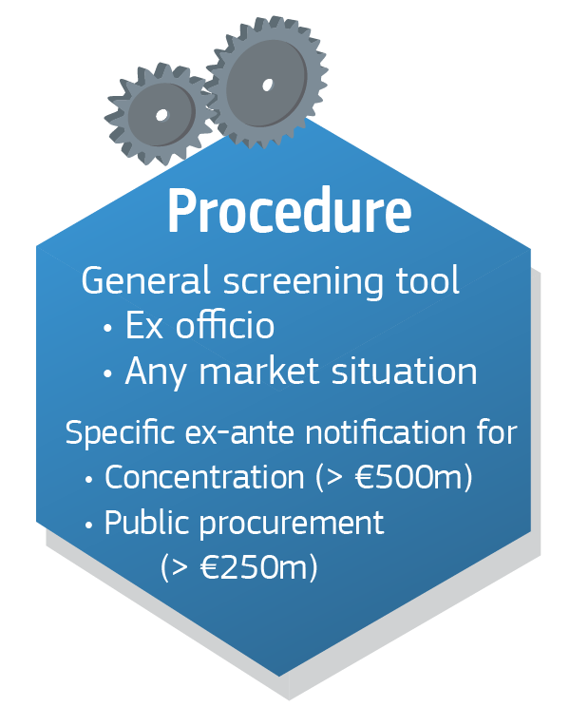
The Commission as sole enforcer
  Uniform application of the rules
  Investigation tools
      Information requests
      Inspections in and outside the Union
      Fines and penalty payments
      Market investigations

Slide 7
Ex ante notifications
  for large concentrations
      EU nexus
        Establishment
        EU turnover (target): at least EUR 500 million
      at least EUR 50 million FFCs in last three years
  for large public procurement procedures
      Value of procurement more than EUR 250 million
      at least EUR 4 million/3rd country FFCs in last three years
  Ad hoc notifications for concentrations or procurements below thresholds
  Suspensive effect

Slide 8
Ex officio review – general screening tool
    Broad scope: any foreign subsidy benefiting an undertaking engaging in an economic activity in the EU
    Information from Member States, competitors, citizens, etc via comp-fsr-registry@ec.europa.eu
    Covers foreign subsidies granted in the 5 years prior to the date of application

Slide 9
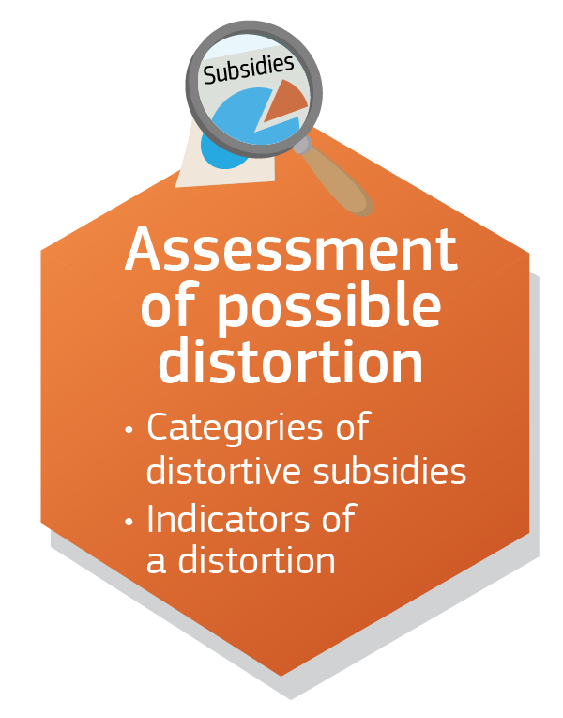
Distortion on the internal market – negative effects on competition
When is a foreign subsidy distortive?
when it improves the competitive position of an undertaking in the internal market and, in doing so, actually or potentially negatively affects competition on the internal market.
How to establish it? => using indicators such as:
amount, nature, purpose of the subsidy
Categories of most likely distortive FS
subsidy to ailing undertaking without restructuring plan
unlimited guarantee
situation of the undertaking or the markets concerned
level of economic activity of the undertaking in the EU
direct facilitation of a concentration
enabling unduly advantageous bid
export financing
Foreign subsidies below EUR 4mio/3y are unlikely to be distortive
Foreign subsidies below EUR 200.000/3rd country/3y are not distortive

Slide 10
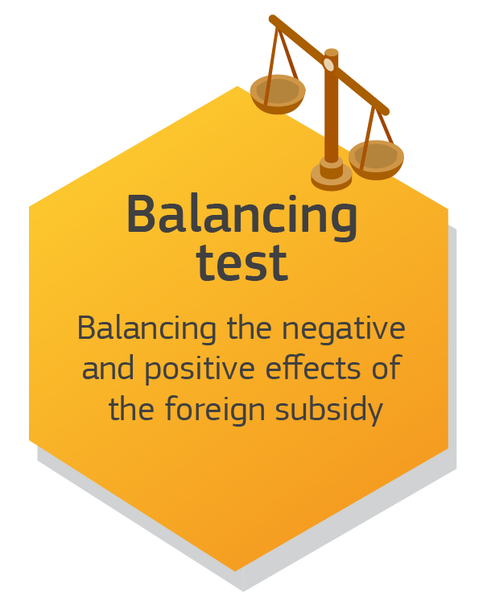
The balancing test
What is the balancing test?
  A foreign subsidy may also have positive effects
  Balancing the negative with the positive effects
What are the possible outcomes of the test?
  Positive effects outweigh negative effects:
  No redressive measures
  Otherwise, positive effects taken into account when establishing redressive measures or commitments

Slide 11




Remedying the distortions
Process:
The undertaking may offer commitments which the Commission would accept if they effectively remedy the distortion
The Commission could also impose proportionate redressive measures
Types of redressive measures (non-exhaustive list):
Structural
Behavioural
Repaying the subsidy
Prohibiting the transaction
Divestment of assets
Adapt governance structure
Give access to infrastructure
Reducing market share
Transparent
Verifiable
Effective
Concentration
Public procurement

Slide 12
Milestones
May 2021
Commission proposal for a Regulation on Foreign Subsidies
November 2022
Adoption by the EP and the Council
12 January 2023
Entry into force
12 October 2023
Start of notification obligation
Start of application
12 July 2023
10 July 2023
Adoption of the FSIR + notification forms

Slide 13
Notifiable and reportable foreign financial contributions - concentrations
Jurisdictional thresholds
Reporting thresholds
Which concentrations are notifiable under the FSR?
EU turnover ≥ € 500 million
Foreign financial contributions > € 50 million/3 years.
Which reporting obligations for foreign financial contributions (FFCs)?
FFCs under Article 5 FSR (“most likely to be distortive”): detailed information for each FFC ≥ €1 million
Other FFCs: Overview if FFCs ≥ € 45 million/3years for a given third country, and for each FFC ≥ €1 million

Slide 14
Reporting of other foreign financial contributions - concentrations
non-Art 5 foreign financial contributions
Information to be provided in table:
- Descriptions by type of FFCs
Ranges of amounts of FFCs per country
Exceptions:
  Goods and services at market conditions
  FFCs to target company
  Deferrals of taxes / double taxation tax reliefs
  Private equities: limitation to acquiring fund

Slide 15
First experiences
Notification of concentrations
  On average 8 notifications per month; no opening of an in-depth investigation yet
Notification of public procurement bids
  2 cases in which an in-depth investigation has been opened
Ex officio
  RFIs in the wind energy sector;
  Unannounced inspection in NL and PL
Guidance on our website (Q&A)

Slide 16
Opportunities and challenges of the FSR
Challenges:
  Fact finding, in particular in case of non-cooperative (companies from) third countries
  Balancing the level of detail for notification requirements with administrative burden
Opportunities:
  More transparency on foreign subsidies
  Prevent distortion of competition caused by foreign subsidies

