Slide 1
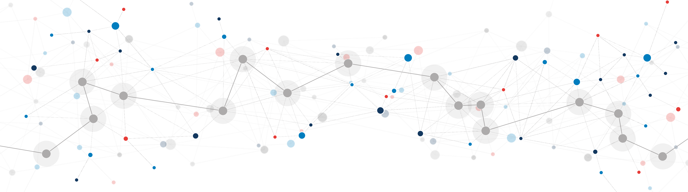
Entrenching Dominance through Buyouts
Jorge Padilla
Opatija, 9 May 2024

Slide 2
Merger can be anti-competitive when entrenching a dominant position
  Raising barriers to entry or expansion
    The recent European Commission (“EC”) prohibition decision of the proposed merger between Booking and eTraveli is seen an example of a merger prohibited primarily on the basis of an ecosystem theory of harm.
    The EC did not appear to be particularly concerned by traditional horizontal or vertical effects, but instead emphasized that the merger would enable Booking to strengthen its position through an expansion of its travel services ecosystem.
    Such ecosystem effects can raise challenges for traditional merger analysis, as there is no necessary link between the products involved; they may be neither substitutes nor complements.
    Hitherto, there is limited public information on the analytical approach that the EC adopted in this case.

Slide 3
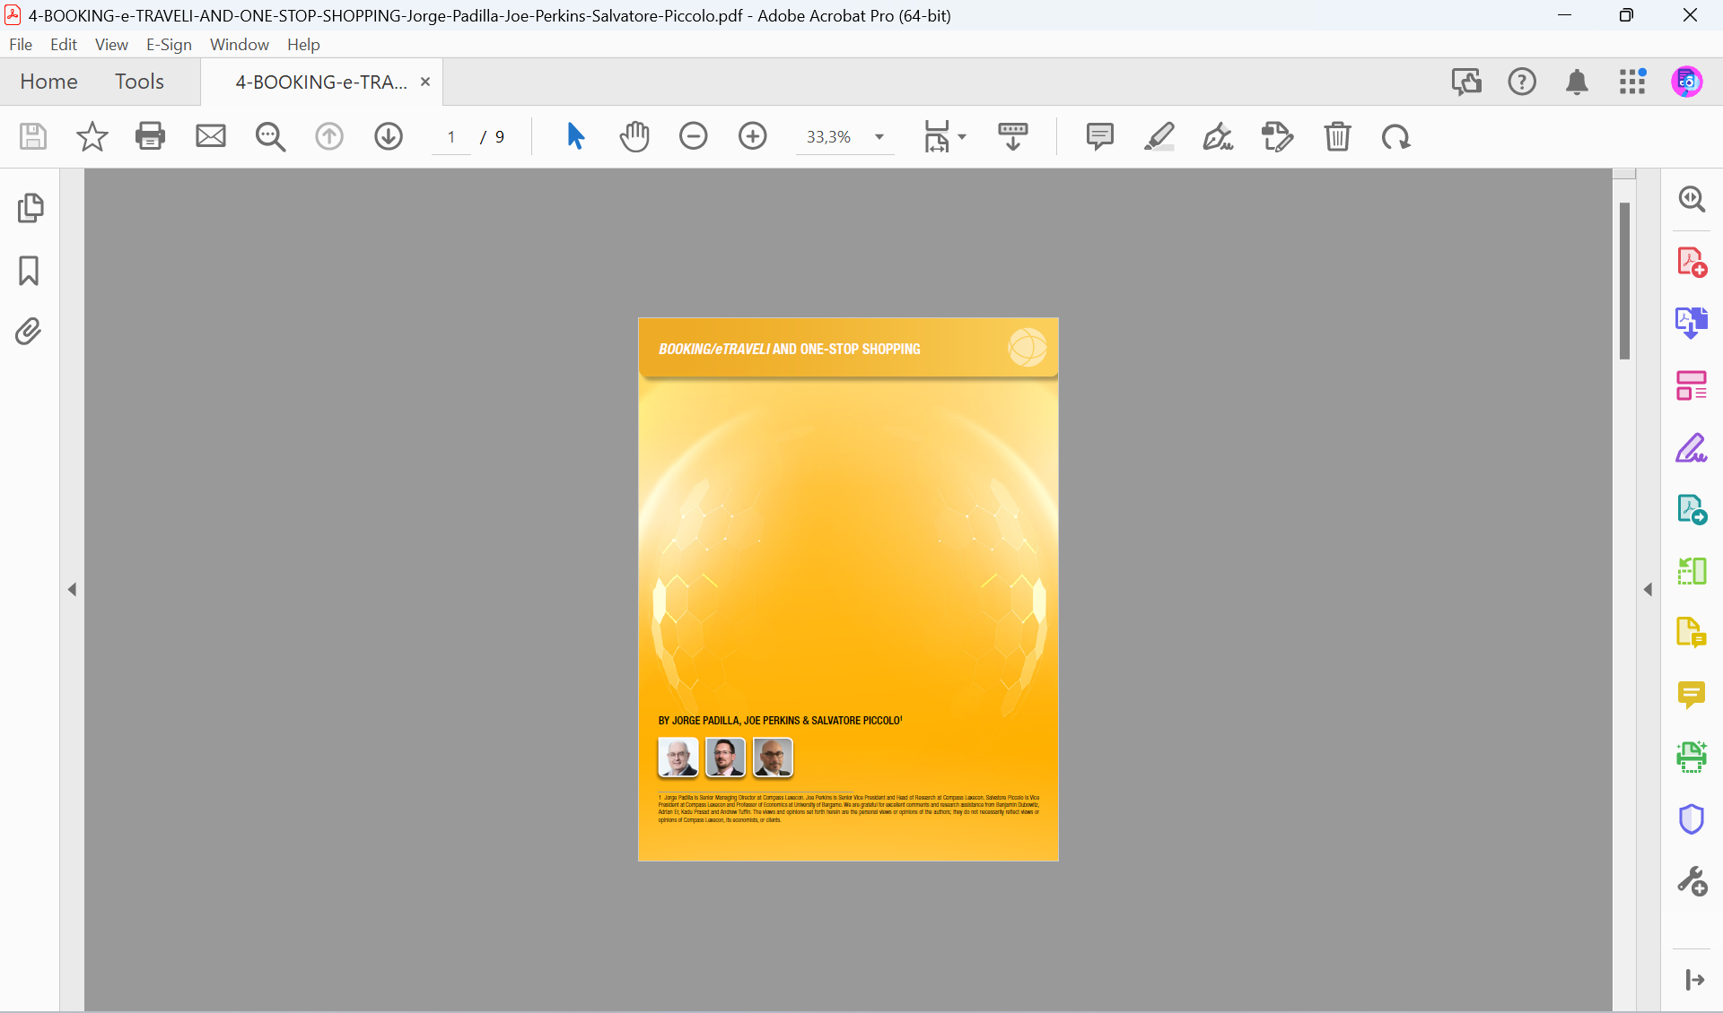
Mergers can be anti-competitive when entrenching a dominant position
  Raising barriers to entry or expansion
    The shopping costs approach is one possible theory of harm connected to ecosystems. This theory suggests an inextricable link between the potential benefits of a merger and its potential harms. That is, the risk of foreclosure only emerges in this framework as a result of the reduced costs that consumers face.
    We expect to see similar dynamics emerging in relation to other theories too, in which the source of the efficiency is also the source of the potential harm. The critical link between efficiencies and potential anti-competitive effects thus makes it particularly important for competition authorities to balance these impacts in their merger assessments.

Slide 4
Mergers can be anti-competitive when entrenching a dominant position
  Eliminating a Nascent Competitive Threat
    A merger may involve a dominant firm acquiring a nascent competitive threat—namely, a firm that could grow into a significant rival, facilitate other rivals’ growth, or otherwise lead to a reduction in its power.
    Nascent threats may be particularly likely to emerge during technological transitions. Technological transitions can render existing entry barriers less relevant, temporarily making incumbents susceptible to competitive threats.
    A dominant firm might seek to acquire firms to help it reinforce or recreate entry barriers so that its dominance endures past the technological transition. Or it might seek to acquire nascent threats that might otherwise gain sufficient customers to overcome entry barriers.
    A nascent competitive threat need not be an actual competitor; it may be a firm operating in an adjacent market which could morph into an actual head-to-head competitor.

Slide 5
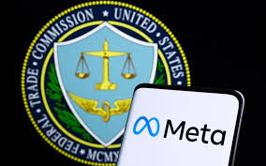
Mergers can be anti-competitive when entrenching a dominant position
  Eliminating a Nascent Competitive Threat
    The FTC's case against Meta focuses on allegations that Meta used a "buy-or-bury" strategy to eliminate competition, acquiring potential rivals like Instagram and WhatsApp to prevent them from becoming threats.
    The FTC argues that these acquisitions allowed Meta to maintain its monopoly power, stifle innovation, and degrade user experience by implementing a surveillance-based advertising model

Slide 6
Mergers as an efficient exit mechanism
Dynamic competition requires free entry, but there is no free entry without free exit.
There are many barriers to exit
    Political barriers to exit
    Legal barriers to entry: inefficient bankruptcy proceedings
    Economic barriers to exit: the public good problem
    Financial barriers to exit: weak banks
  Facilitating exit can lead to greater investment
    Demand uncertainty
    Fixed costs
    Profitable exit as efficient insurance

Slide 7
Mergers as an efficient exit mechanism
Solving the public good problem
Bankruptcy is typically inefficient

Slide 8
Who is eliminating the nascent competitive threat? Does it matter?
Mergers among market laggards (new entrants or
innovation challengers) should be treated differently
than those involving leaders (established players or
first-mover innovators)
These mergers can be rivalry-enhancing, either by
accelerating entry or promoting innovations,
leading to lower quality-adjusted prices and
higher consumer surplus.
This is more likely to happen when entry (or innovation)
costs are relatively high, so that entry (or innovation)
is profitable only when it is limited to a few players, and
demand is uncertain.

Slide 9
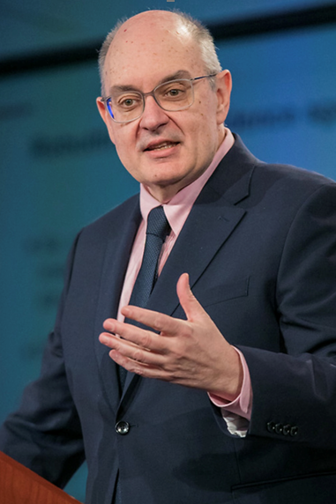
Thank you!
jpadilla@compasslexecon.com
View my research on my SSRN author page: http://ssrn.com/author=47132
Notes:
Thank you very much for your attention!

